Slide 1
Programming Massively Parallel Processors
Chapter 2-3:
Cuda Programming Model
Introduction to CUDA C
© David Kirk/NVIDIA and Wen-mei W. Hwu, 2007-2011 ECE408/CS483, University of Illinois, Urbana-Champaign

Slide 2
Lecture 1:
The CUDA Programming Model

Slide 3
CUDA /OpenCL – Execution Model
Integrated host+device app C program
  Serial or modestly parallel parts in host C code
  Highly parallel parts in device SPMD kernel C code
Serial Code (host)‏
Parallel Kernel (device)‏
KernelA<<< nBlk, nTid >>>(args);
. . .
Serial Code (host)‏
Parallel Kernel (device)‏
KernelB<<< nBlk, nTid >>>(args);
. . .
© David Kirk/NVIDIA and Wen-mei W. Hwu, 2007-2011 ECE408/CS483, University of Illinois, Urbana-Champaign

Slide 4
Vector Addition – Conceptual View
vector A
A[0]
A[1]
A[2]
A[3]
A[4]
A[N-1]
…
vector B
B[0]
B[1]
B[2]
B[3]
B[4]
…
B[N-1]
+
+
+
+
+
+
vector C
C[0]
C[1]
C[2]
C[3]
C[4]
C[N-1]
…
© David Kirk/NVIDIA and Wen-mei W. Hwu, 2007-2011 ECE408/CS483, University of Illinois, Urbana-Champaign

Slide 5
Vector Addition – Traditional C Code
// Compute vector sum C = A+B
void vecAdd(float* A, float* B, float* C, int n)
{
for (i = 0, i < n, i++)
C[i] = A[i] + B[i];
}
int main()
{
// Memory allocation for A_h, B_h, and C_h
// I/O to read A_h and B_h, N elements
…
vecAdd(A_h, B_h, C_h, N);
}
© David Kirk/NVIDIA and Wen-mei W. Hwu, 2007-2011 ECE408/CS483, University of Illinois, Urbana-Champaign

Slide 6
Heterogeneous Computing vecAdd Host Code
Part 1
#include <cuda.h>
void vecAdd(float* A, float* B, float* C, int n)‏
{
int size = n* sizeof(float);
float* A_d, B_d, C_d;
…
1. // Allocate device memory for A, B, and C
// copy A and B to device memory
2. // Kernel launch code – to have the device
// to perform the actual vector addition
3. // copy C from the device memory
// Free device vectors
}
Host Memory
Device Memory
CPU
GPU
Part 2
Part 3
© David Kirk/NVIDIA and Wen-mei W. Hwu, 2007-2011 ECE408/CS483, University of Illinois, Urbana-Champaign

Slide 7
Partial Overview of CUDA Memories
Device code can:
  R/W per-thread registers
  R/W per-grid global memory
Host code can
  Transfer data to/from per grid global memory
(Device) Grid
Block (0, 0)
Block (1, 0)
Registers
Registers
Registers
Registers
Thread (0, 0)
Thread (1, 0)
Thread (0, 0)
Thread (1, 0)
We will cover more later. Do not worry
Host
Global
Memory
© David Kirk/NVIDIA and Wen-mei W. Hwu, 2007-2011 ECE408/CS483, University of Illinois, Urbana-Champaign
Notes:
Global, constant, and texture memory spaces are persistent across kernels called by the same application.

Slide 8
STOP HERE FOR A SEC
Before we talk more about CUDA we need to talk a little bit more about GPU memory and learn a couple of things about it
© David Kirk/NVIDIA and Wen-mei W. Hwu, 2007-2009
ECE 498AL, University of Illinois, Urbana-Champaign

Slide 9
CUDA Memory Model Overview
Global memory
  Main mean of communicating R/W Data between host and device
  Contents visible to all threads
  Long latency access
We will focus on global memory for now
  Constant and texture memory will come later
Grid
Block (0, 0)‏
Block (1, 0)‏
Shared Memory
Shared Memory
Registers
Registers
Registers
Registers
Thread (0, 0)‏
Thread (1, 0)‏
Thread (0, 0)‏
Thread (1, 0)‏
Host
Global Memory
© David Kirk/NVIDIA and Wen-mei W. Hwu, 2007-2009
ECE 498AL Spring 2010, University of Illinois, Urbana-Champaign

Slide 10
CUDA Device Memory Allocation
cudaMalloc()
  Allocates object in the device Global Memory
  Requires two parameters
    Address of a pointer to the allocated object
    Size of of allocated object
cudaFree()
  Frees object from device Global Memory
    Pointer to freed object
Grid
Block (0, 0)‏
Block (1, 0)‏
Shared Memory
Shared Memory
Registers
Registers
Registers
Registers
Thread (0, 0)‏
Thread (1, 0)‏
Thread (0, 0)‏
Thread (1, 0)‏
Host
Global
Memory
© David Kirk/NVIDIA and Wen-mei W. Hwu, 2007-2009
ECE 498AL Spring 2010, University of Illinois, Urbana-Champaign

Slide 11
CUDA Device Memory Allocation (cont.)‏
Code example:
  Allocate a 64 * 64 single precision float array
  Attach the allocated storage to Md
  “d” is often used to indicate a device data structure
TILE_WIDTH = 64;
Float* Md
int size = TILE_WIDTH * TILE_WIDTH * sizeof(float);
cudaMalloc((void**)&Md, size);
:
cudaFree(Md);

Slide 12
CUDA Host-Device Data Transfer
cudaMemcpy()
  memory data transfer
  Requires four parameters
    Pointer to destination
    Pointer to source
    Number of bytes copied
    Type of transfer
      Host to Host
      Host to Device
      Device to Host
      Device A to Device A (Same)
Grid
Block (0, 0)‏
Block (1, 0)‏
Shared Memory
Shared Memory
Registers
Registers
Registers
Registers
Thread (0, 0)‏
Thread (1, 0)‏
Thread (0, 0)‏
Thread (1, 0)‏
Host
Global
Memory
From the perspective of the host:
Data transfers are blocking or synchronous transfers
Kernel launch is asynchronous.

Slide 13
CUDA Host-Device Data Transfer
(cont.)
Code example:
  Transfer a 64 * 64 single precision float array
  M is in host memory and Md is in device memory
  cudaMemcpyHostToDevice and cudaMemcpyDeviceToHost are symbolic constants
FORMAT: cudaMemcpy(Destination, source, sizeInBytes, Direction)
cudaMemcpy(Md, M, size, cudaMemcpyHostToDevice);
cudaMemcpy(M, Md, size, cudaMemcpyDeviceToHost);
© David Kirk/NVIDIA and Wen-mei W. Hwu, 2007-2009
ECE 498AL Spring 2010, University of Illinois, Urbana-Champaign

Slide 14
void vecAdd(float* A, float* B, float* C, int n)
{
int size = n * sizeof(float);
float* A_d, B_d, C_d;
1. // Transfer A and B to device memory
cudaMalloc((void **) &A_d, size);
cudaMemcpy(A_d, A, size, cudaMemcpyHostToDevice);
cudaMalloc((void **) &B_d, size);
cudaMemcpy(B_d, B, size, cudaMemcpyHostToDevice);
// Allocate device memory for
cudaMalloc((void **) &C_d, size);
2. // Kernel invocation code – to be shown later
…
3. // Transfer C from device to host
cudaMemcpy(C, C_d, size, cudaMemcpyDeviceToHost);
// Free device memory for A, B, C
cudaFree(A_d); cudaFree(B_d); cudaFree (C_d);
}
© David Kirk/NVIDIA and Wen-mei W. Hwu, 2007-2011 ECE408/CS483, University of Illinois, Urbana-Champaign

Slide 15
Example
Hello World
Next slide
© David Kirk/NVIDIA and Wen-mei Hwu, 2007-2012 ECE408/CS483/ECE498al, University of Illinois, Urbana-Champaign

Slide 16
#include <stdio.h>
const int N = 7;
const int blocksize = 7;
//=====================================================
__global__
void hello(char *a, int *b)
{
a[threadIdx.x] += b[threadIdx.x];
}
//=====================================================
int main()
{
char a[N] = "Hello ";
int b[N] = {15, 10, 6, 0, -11, 1, 0};
char *ad; int *bd;
const int csize = N*sizeof(char);
const int isize = N*sizeof(int);
printf("%s", a);
cudaMalloc( (void**)&ad, csize );
cudaMalloc( (void**)&bd, isize );
cudaMemcpy( ad, a, csize, cudaMemcpyHostToDevice );
cudaMemcpy( bd, b, isize, cudaMemcpyHostToDevice );
dim3 dimGrid( 1, 1 );
dim3 dimBlock( blocksize, 1 );
hello<<<dimGrid, dimBlock>>>(ad, bd);
cudaMemcpy( a, ad, csize, cudaMemcpyDeviceToHost );
cudaFree( ad );
cudaFree( bd );
printf("%s\n", a);
return EXIT_SUCCESS;
}

Slide 17
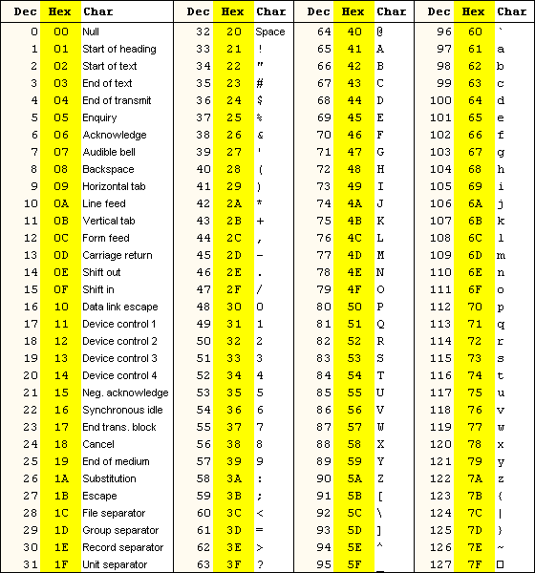

© David Kirk/NVIDIA and Wen-mei Hwu, 2007-2012 ECE408/CS483/ECE498al, University of Illinois, Urbana-Champaign

Slide 18
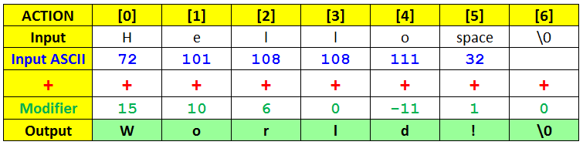
© David Kirk/NVIDIA and Wen-mei Hwu, 2007-2012 ECE408/CS483/ECE498al, University of Illinois, Urbana-Champaign

Slide 19
Let’s run the code in Maverick2
TACC
Login into your TACC account
Transfer the code and script to the folder of your choice
Using putty locate the folder in which you put the code and script
sbacth mvk2CudaScript
Wait a couple of seconds
Refresh, check for error, or check result (*.out file)

Slide 20
About Maverick2 - TACC
Maverick2 uses SLURM as job scheduler
Here some helpful SLURM commands:
https://docs.rc.fas.harvard.edu/kb/convenient-slurm-commands/#Information_on_jobs
https://www.hpc.kaust.edu.sa/sites/default/files/files/public/20160710%20SlurmCommands.pdf

Slide 21
How to Compile in Turing
(MSU GPU Node)
Login into
Transfer the code and script to the folder of your choice
Using putty login into Turing
ssh gpu (now you are in the GPU node)
Compile:
[colmenares@turing cuda]$ /opt/cuda-8.0/bin/nvcc helloWorld.cu -o ExeHello
6. Execute: [colmenares@gpu cuda]$ ./ExeHello → Hello World!

Slide 22
Arrays of Parallel Threads
A CUDA kernel is executed by a grid (array) of threads
  All threads in a grid run the same kernel code (SPMD)‏
  Each thread has an index that it uses to compute memory addresses and make control decisions
0
1
2
254
255
…
i = blockIdx.x * blockDim.x + threadIdx.x;
C_d[i] = A_d[i] + B_d[i];
…

Slide 23
Thread Blocks
When the kernel is called/invoked by the host, a GRID of threads is generated.
This Grid is organized in a two (2) level hierarchy
An array of thread blocks (Blocks)
  All Blocks in Grid have the same size
  Max 1024 threads per block (CUDA 3.0 or later), before that (Max 512).
  blockDim is a variable, gives the # of threads in block
    blockDim.x → MORE LATER

Slide 24
Thread Blocks
Recommended: For reason of efficiency, the dimensions of thread blocks should be multiple of 32
Blocks inside a grid have a unique ID. This ID is given by blockIdx (0, 1, 2, …., etc)
Threads inside a block, have a unique ID. This ID is given by threadIdx. (0, 1, 2 …., etc)
You can combine
  blockDim
  blockIdx
  threadIdx
  To create a Unique GLOBAL index
  Example: i = blockIdx.x * blockDim.x + threadIdx.x

Slide 25
Thread Blocks: Scalable Cooperation
Divide thread array into multiple blocks
  Threads within a block cooperate via shared memory, atomic operations and barrier synchronization
  Threads in different blocks cannot cooperate
Thread Block 0
Thread Block 1
Thread Block N-1
0
1
2
254
255
0
1
2
254
255
0
1
2
254
255
…
…
…
i = blockIdx.x * blockDim.x + threadIdx.x;
C_d[i] = A_d[i] + B_d[i];
i = blockIdx.x * blockDim.x + threadIdx.x;
C_d[i] = A_d[i] + B_d[i];
i = blockIdx.x * blockDim.x + threadIdx.x;
C_d[i] = A_d[i] + B_d[i];
…
…
…
…

Slide 26
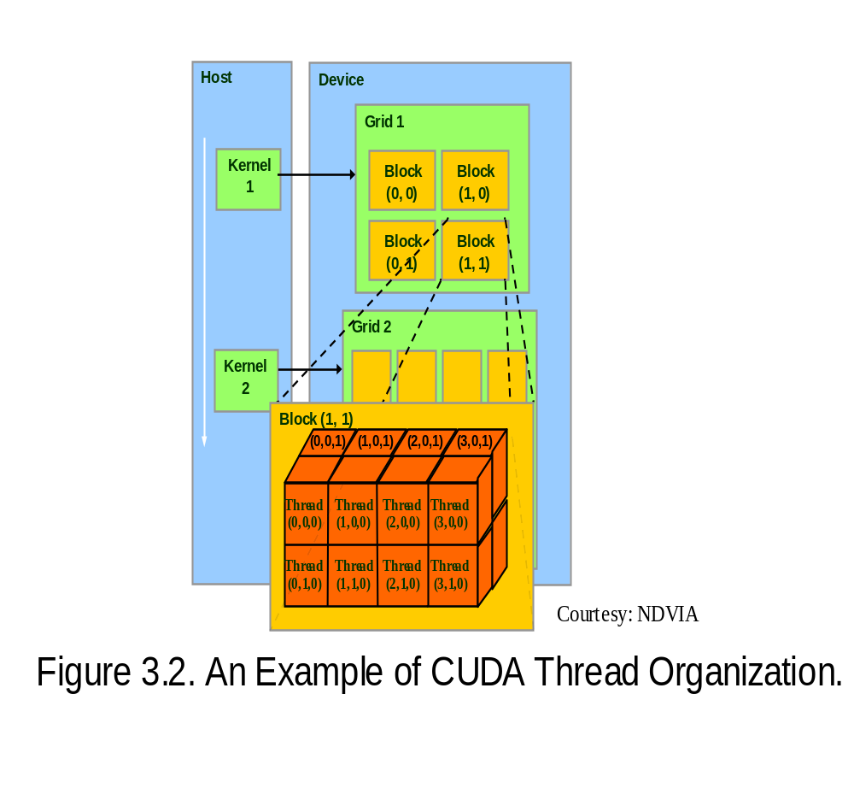
blockIdx and threadIdx
Each thread uses indices to decide what data to work on
  blockIdx: 1D, 2D, or 3D (CUDA 4.0)
  threadIdx: 1D, 2D, or 3D
Simplifies memory
addressing when processing
multidimensional data
  Image processing
  Solving PDEs on volumes
  …
© David Kirk/NVIDIA and Wen-mei W. Hwu, 2007-2011 ECE408/CS483, University of Illinois, Urbana-Champaign

Slide 27
More on CUDA Function Declarations
Executed on the:
Only callable from the:
__device__ float DeviceFunc()‏
device
device
__global__ void KernelFunc()‏
device
host
__host__ float HostFunc()‏
host
host
__global__ defines a kernel function
  Each “__” consists of two underscore characters
  A kernel function must return void
__device__ and __host__ can be used together
© David Kirk/NVIDIA and Wen-mei W. Hwu, 2007-2011 ECE408/CS483, University of Illinois, Urbana-Champaign

Slide 28
Example: Vector Addition Kernel
Device Code
// Compute vector sum C = A+B
// Each thread performs one pair-wise addition
__global__
void vecAddKernel(float* A_d, float* B_d, float* C_d, int n)
{
int i = threadIdx.x + blockDim.x * blockIdx.x;
if(i<n) C_d[i] = A_d[i] + B_d[i];
}
int vectAdd(float* A, float* B, float* C, int n)
{
// A_d, B_d, C_d allocations and copies omitted
// Run ceil(n/256) blocks of 256 threads each
vecAddKernel<<<ceil(n/256), 256>>>(A_d, B_d, C_d, n);
}
© David Kirk/NVIDIA and Wen-mei W. Hwu, 2007-2011 ECE408/CS483, University of Illinois, Urbana-Champaign

Slide 29
Example: Vector Addition Kernel
// Compute vector sum C = A+B
// Each thread performs one pair-wise addition
__global__
void vecAddkernel(float* A_d, float* B_d, float* C_d, int n)
{
int i = threadIdx.x + blockDim.x * blockIdx.x;
if(i<n) C_d[i] = A_d[i] + B_d[i];
}
int vecAdd(float* A, float* B, float* C, int n)
{
// A_d, B_d, C_d allocations and copies omitted
// Run ceil(n/256) blocks of 256 threads each
vecAddKernnel<<<ceil(n/256),256>>>(A_d, B_d, C_d, n);
}
Host Code
© David Kirk/NVIDIA and Wen-mei W. Hwu, 2007-2011 ECE408/CS483, University of Illinois, Urbana-Champaign

Slide 30
void vecAdd(float* A, float* B, float* C, int n)
{
int size = n * sizeof(float);
float* A_d, B_d, C_d;
1. // Transfer A and B to device memory
cudaMalloc((void **) &A_d, size);
cudaMemcpy(A_d, A, size, cudaMemcpyHostToDevice);
cudaMalloc((void **) &B_d, size);
cudaMemcpy(B_d, B, size, cudaMemcpyHostToDevice);
// Allocate device memory for
cudaMalloc((void **) &C_d, size);
2. //vecAddKernnel<<<DimGrid,DimBlock>>>(A_d, B_d, C_d, n);
3. // Transfer C from device to host
cudaMemcpy(C, C_d, size, cudaMemcpyDeviceToHost);
// Free device memory for A, B, C
cudaFree(A_d); cudaFree(B_d); cudaFree (C_d);
}
© David Kirk/NVIDIA and Wen-mei W. Hwu, 2007-2011 ECE408/CS483, University of Illinois, Urbana-Champaign

Slide 31
QUESTIONS?
© David Kirk/NVIDIA and Wen-mei W. Hwu, 2007-2011 ECE408/CS483, University of Illinois, Urbana-Champaign

